Slide 1
Procedural
Content Generation
for Computer Games
Author: Tom Smith (taes1g09@ecs.soton.ac.uk)
Supervisor: Rikki Prince (rfp@ecs.soton.ac.uk)
Notes:
[Kick off:]
Hi, I'm Tom Smith, and I'm going to be presenting on the topic of procedural content generation for computer games.

Slide 2
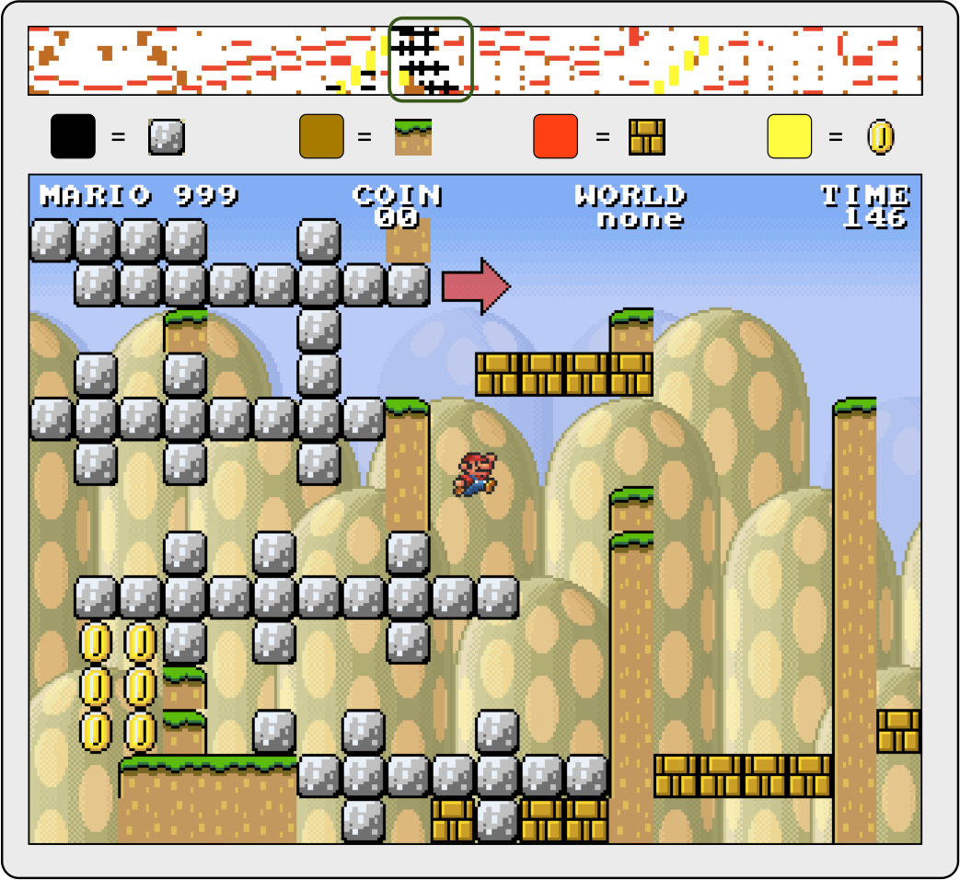
What is Procedural
Content Generation?
Procedural Content Generation has been used by hundreds of commercially successful games, from Elite (1984) to Assassins Creed 3 (2012). But what is it?
Notes:
What do we know about procedural content generation?
Well, it's increasingly being used by modern games, but it's been around for ages. It lets artists and designers produce more varied content more efficiently, and can even generate content that responds to the players actions.

Slide 3

What is Procedural
Content Generation?
Procedural Content Generation has been used by hundreds of commercially successful games, from Elite (1984) to Assassins Creed 3 (2012). But what is it?
Notes:
But what actually is it?
Well, it turns out that there's no widely agreed definition:

Slide 4
What is Procedural
Content Generation?
Procedural Content Generation has been used by hundreds of commercially successful games, from Elite (1984) to Assassins Creed 3 (2012). But what is it?
“the application of computers to generate game content, distinguish interesting instances among the ones generated, and select entertaining instances on behalf of the players.”
- Hendrikx et al.
Notes:
Two recent surveys have attempted to provide concise definitions. Hendrikx et al in 2012 called it “the application of computers to generate game content, distinguish interesting instances among the ones generated, and select entertaining instances on behalf of the players.” - but this definition is insufficient as it doesn't cover unevaluated or human-evaluated generation, only allowing for content evaluated by the computer.

Slide 5
What is Procedural
Content Generation?
Procedural Content Generation has been used by hundreds of commercially successful games, from Elite (1984) to Assassins Creed 3 (2012). But what is it?
“the algorithmical creation of game content with limited or indirect user input.”
- Togelius et al. 2011
Notes:
Togelius et al. in 2011 provided a broader definition: “the algorithmical creation of game content with limited or indirect user input.”. They specifically note that they don't attempt to define the presence or absence of adaptivity or randomness.

Slide 6
What is Procedural
Content Generation?
Procedural Content Generation has been used by hundreds of commercially successful games, from Elite (1984) to Assassins Creed 3 (2012). But what is it?
“the algorithmical creation of game content with limited or indirect user input.”
- Togelius et al. 2011
PCG techniques often use methods from the related fields of dynamic difficulty adjustment, particle systems, evolutionary algorithms, cellular automata and AI.
Notes:
There's also an issue of how to define the separation between PCG and related concepts. PCG techniques often use methods from the related fields of dynamic difficulty adjustment, particle systems, evolutionary algorithms, cellular automata and AI, and it can be difficult to know where these end and 'true' (for some value of true) PCG begins.
As a closing note: I'd like to point out that I feel the widely-accepted term procedural *content* generation is a little over-specific, as these days there's a lot of other things being generated using similar techniques - there are approaches I'll cover later that could more accurately be describe as procedural *experience* generation, and that thumbnail - or rather, this image

Slide 7
What is Procedural
Content Generation?
Notes:
is an Infinite Mario variant that is actually a procedural procedural level generator generator.
Okay.

Slide 8

Online PCG vs. Offline PCG
PCG can be performed at a number of different stages.
Notes:
First thing:
PCG can be performed at a number of different stages.

Slide 9
Online PCG vs. Offline PCG
PCG can be performed at a number of different stages.
▸ “Offline” PCG techniques
▹ Performed at development or load time
Notes:
To begin with “Offline” PCG techniques - these are performed at development or load time
There's actually a distinct difference here: when it's performed at development time, it obviously uses the developers computers. There's two main options: in the first, the developers can run the process themselves and bake the results into the game files. This can save workload - for example, generating a forest rather than hand-placing each tree - but doesn't reduce the storage needed to deliver that content. However, it can use an algorithm that requires heavy processing as it's done by the developers, and can allow for manual polishing.

Slide 10

Online PCG vs. Offline PCG
PCG can be performed at a number of different stages.
▸ “Offline” PCG techniques
▹ Performed at development or load time
Notes:
Alternatively, the developers can specify an algorithm and a range of parameters or seeds, and leave the actual generation to be performed as the game or level loads. If the algorithm is stochastic, this can give results that are apparently similar to the previous method, but require drastically less storage. John Carmack of iD software has called PCG an *ahem* lousy [crappy] form of data compression, and it can be used for that, but the power comes in when the algorithm used is non-deterministic (stochastic) - ion which case the results can vary between generations.

Slide 11

Online PCG vs. Offline PCG
PCG can be performed at a number of different stages.
▸ “Offline” PCG techniques
▹ Performed at development or load time
▸ “Online” PCG methods
▹ Performed during game execution
▹ Can use runtime information
Notes:
Finally, there are "online" methods of procedural content generation, run during game execution. These provide much of the same benefits as offline techniques, however they are more demanding, as they've got to compete for processor time with rendering and physics and traditional AI. They come with a significant upside however, as they allow the generated content to be influenced by actions of the player.

Slide 12
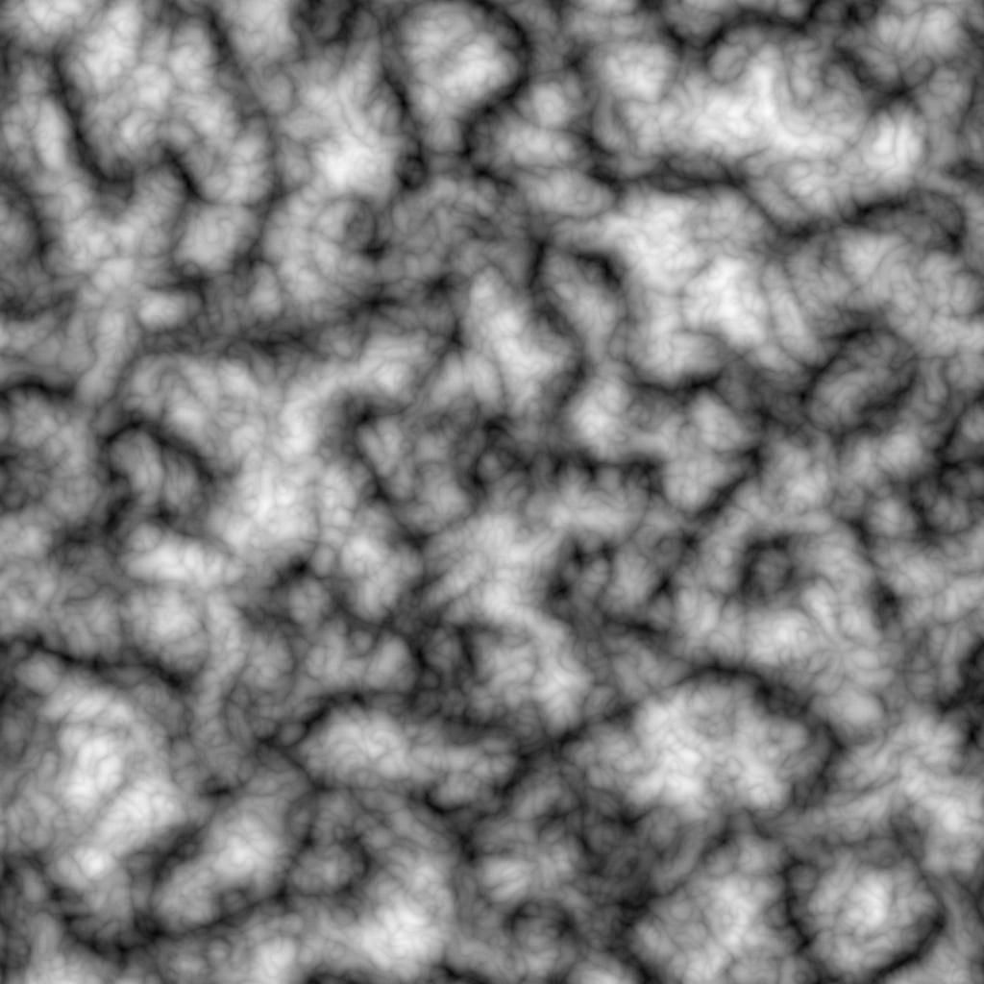
PCG for Artists
Artists use a range PCG techniques to generate many content types. These typically generate static content, and are widely used in other GGI industries.
Notes:
Artists use a range PCG techniques to generate multiple content types. These are typically offline algorithms for generating static content, and as such there's a lot of cross-industry use for films and CGI for print media.
The use of PCG allows artists to make content creation more efficient, and to produce more varied content:
Some example content kinds:

Slide 13
PCG for Artists
Artists use a range PCG techniques to generate many content types. These typically generate static content, and are widely used in other GGI industries.
▸ Textures
Notes:
For Textures, there are Image Filtering techniques, PRNGs and Perlin noise pictured here. Was originally developed by Ken Perlin for the motion picture industry,

Slide 14
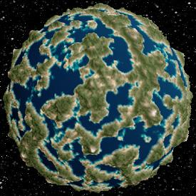
PCG for Artists
Artists use a range PCG techniques to generate many content types. These typically generate static content, and are widely used in other GGI industries.
▸ Textures
Notes:
3D and 4D versions have since been developed, and even the 2D patterns can be mapped onto 3D objects

Slide 15
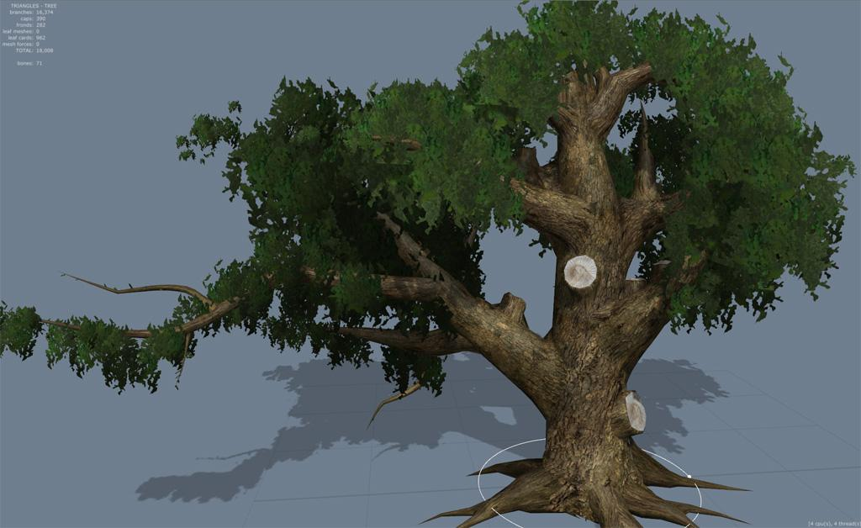
PCG for Artists
Artists use a range PCG techniques to generate many content types. These typically generate static content, and are widely used in other GGI industries.
▸ Textures
▸ Models
Notes:
for Models: the Component-Assembly method using generative grammars - start with a kernel of hand-created pieces, and then use a parameterised algorithm that specifies valid ways to put them together
- A well-known commercial implementation of this is the middleware speedtree - used in games such as Oblivion, Batman and Halo 4, and films such as Avatar and Life of Pi.

Slide 16
PCG for Artists
Artists use a range PCG techniques to generate many content types. These typically generate static content, and are widely used in other GGI industries.
▸ Textures
▸ Models
▸ Music
Notes:
Music - synthesise interesting and non-repetitive music that can respond to actions in the game world

Slide 17

PCG for Artists
Artists use a range PCG techniques to generate many content types. These typically generate static content, and are widely used in other GGI industries.
▸ Textures
▸ Models
▸ Music
▸ Animations
Notes:
Animations - again, there's an offline and an online component to this. With games such as Assassins creed 3 having upwards of 7000 animations for the player character alone, the core movement structure is created using traditional methods (motion capture or keyframing) and interstitial transition animations procedurally generated. Then there's an onine component, which is used to allow entities to animate in response to conditions that couldn't have been known at design time - again, there's a middleware for this called Euphoria, which purports to use a skeletomuscular simulation. Finally, there are games like spore that procedurally animate player creations, but these are kind of a special case.

Slide 18
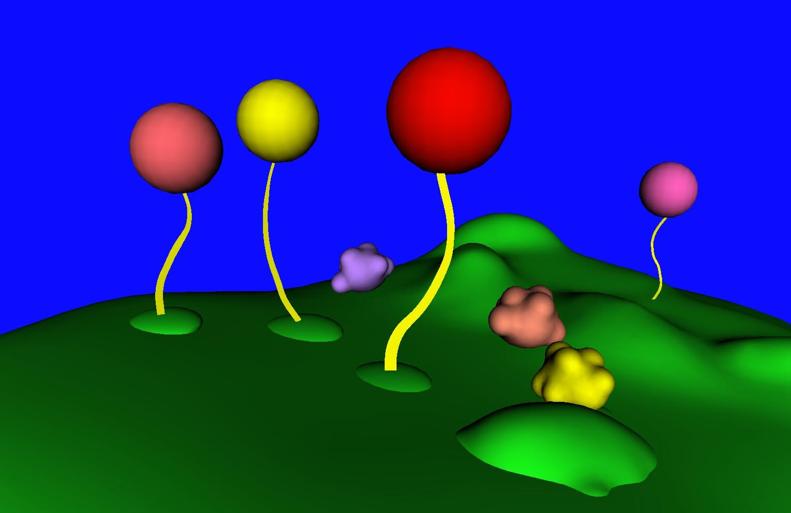
PCG for Artists
Artists use a range PCG techniques to generate many content types. These typically generate static content, and are widely used in other GGI industries.
▸ Textures
▸ Models
▸ Music
▸ Animations
▸ Effects
Notes:
Finally, there's a whole class of procedural Effects, such as procedural particle systems such as the evolving weapons systems from Galactic Arms Race, or procedural rendering effects such as these Seussian trees

Slide 19

PCG for Artists
Artists use a range PCG techniques to generate many content types. These typically generate static content, and are widely used in other GGI industries.
▸ Textures
▸ Models
▸ Music
▸ Animations
▸ Effects
Notes:
[pause]

Slide 20
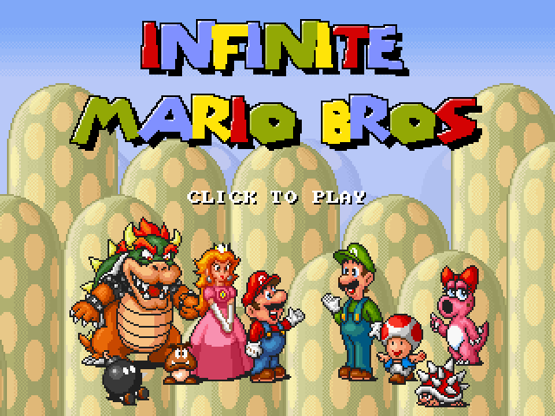

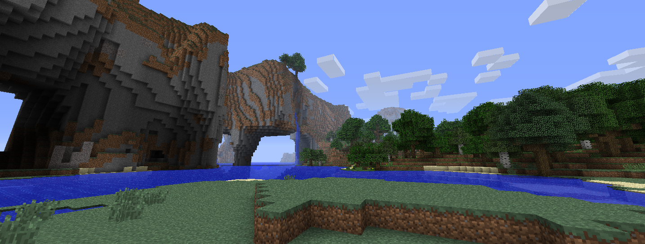
PCG for Designers
The use of PCG methods bring several benefits to
developers.
Notes:
In addition to static assets, PCG approaches can be used to generate a variety of other types of content: indoor and outdoor environments, and even the specific behaviours of NPCs, weapons and vehicles.

Slide 21
PCG for Designers
The use of PCG methods bring several benefits to
developers, enabling:
▸ Content Scale enhancements
Notes:
The use of PCG methods bring several benefits to developers.
They can make it far faster to produce content on a grander scale and with higher detail than is possible - or rather feasible - via hand-crafted creation. To begin with PCG approaches can populate large handcrafted areas - spreading grass, forests or even opponents throughout an area can be as simple as applying the relevant algorithm. Secondly, near-limitless areas can be generated from scratch, by providing an algorithm that expands the world whenever borders are approached.

Slide 22
PCG for Designers
The use of PCG methods bring several benefits to
developers, enabling:
▸ Content Scale enhancements
▸ Replay Value improvement
Notes:
Another benefit provided by the use of PCG is the potential increase in Replay Value: if the algorithm used for generating content is non-deterministic then generated content can vary between playthroughs - and generation can even be influenced by actions that the player takes.

Slide 23
PCG for Designers
The use of PCG methods bring several benefits to
developers, enabling:
▸ Content Scale enhancements
▸ Replay Value improvement
▸ Challenge Adjustment systems
Notes:
Which leads on to Challenge Adjustment systems: online PCG algorithms can use player metrics to adjust the challenge of procedurally generated content - this can be more effective than traditional dynamic difficulty adjustment as more significant changes are possible.

Slide 24
PCG for Designers
The use of PCG methods bring several benefits to
developers, enabling:
▸ Content Scale enhancements
▸ Replay Value improvement
▸ Challenge Adjustment systems
Two particularly active research areas.
Notes:
There's a lot of active research areas among developers' PCG systems, possibly because more of them are programmers already and so have the skills to develop new systems. There are two that are particularly interesting.

Slide 25
PCG for Designers
The use of PCG methods bring several benefits to
developers, enabling:
▸ Content Scale enhancements
▸ Replay Value improvement
▸ Challenge Adjustment systems
Two particularly active research areas are:
▸ Search-based PCG techniques
Notes:
Since developers often can't evaluate the output of their algorithms in the same way that artists can, as so many of the algorithms run online, automatic evaluation methods are often necessary. Search-based PCG techniques are an increasingly popular approach that use Fitness functions to evaluate generated content and select increasingly 'fit' individuals to present.

Slide 26
PCG for Designers
The use of PCG methods bring several benefits to
developers, enabling:
▸ Content Scale enhancements
▸ Replay Value improvement
▸ Challenge Adjustment systems
Two particularly active research areas are:
▸ Search-based PCG techniques
▸ Mixed-Initiative content creation
Notes:
On the other hand, in mixed-initiative content creation, developers provide known good hand-crafted 'set pieces', and allow the algorithm to generate appropriate content between them - which takes advantage of the still unique creativity of human designers, while still providing the scale afforded by PCG systems

Slide 27
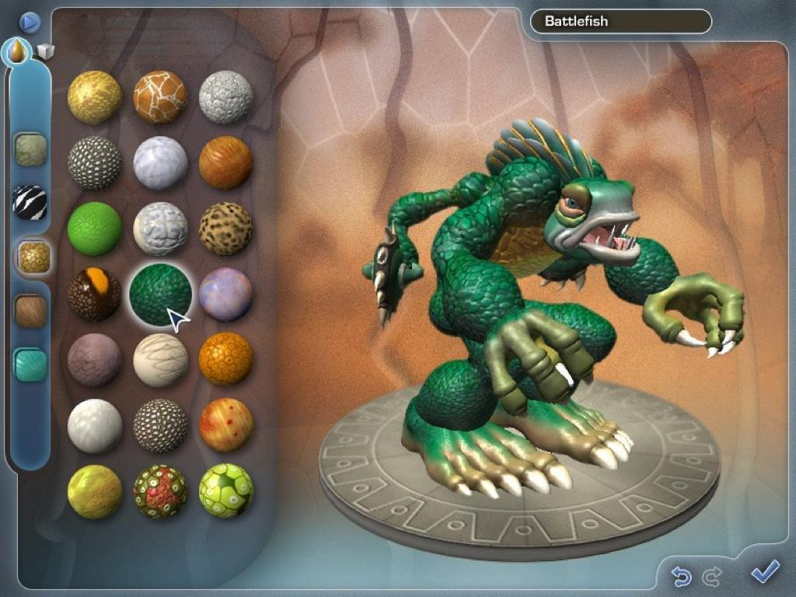
PCG for Consumers
Some games use information about the player to tailor
content at runtime.
Notes:
Increasingly, modern games use information about the player to tailor content at runtime. This is more possible now that computers are in general more powerful, as online algorithms compete with other game systems for processor time.
Currently, user focussed-PCG falls into one of two camps.

Slide 28
PCG for Consumers
Some games use information about the player to tailor
content at runtime, to improve:
▸ Experience of gameplay overall
Notes:
The first looks at improving the player's experience overall. These tend to be heavily AI-based systems that form a model of some aspect of the player, make decisions based upon that model, and then generated content based upon those decisions.

Slide 29
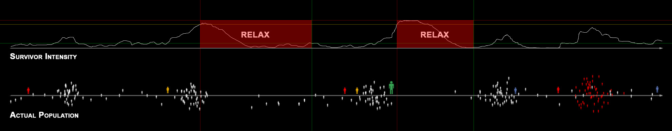
PCG for Consumers
Some games use information about the player to tailor
content at runtime, to improve:
▸ Experience of gameplay overall
▹ Valve’s ‘AI Director’
Notes:
One well-known example is Valve’s ‘AI Director’ - which constructs a model of the player's 'emotional intensity' and spawns enemies in order to help it follow an established rhythm to maintain tension. They call it structured unpredictability.

Slide 30
PCG for Consumers
Some games use information about the player to tailor
content at runtime, to improve:
▸ Experience of gameplay overall
▹ Valve’s ‘AI Director’
▹ Bethesda’s ‘Radiant Story’
Notes:
Another example is Bethesda’s ‘Radiant Story’ - which constructs a model of where the player has been, and then generates quests designed to encourage exploration.

Slide 31
PCG for Consumers
Some games use information about the player to tailor
content at runtime, to improve:
▸ Experience of gameplay overall
▹ Valve’s ‘AI Director’
▹ Bethesda’s ‘Radiant Story’
▸ Agency available to players
Notes:
Another use for user-focussed is to increase the Agency that players perceive is available to them in the game world, often via providing player-driven content generation.

Slide 32

PCG for Consumers
Some games use information about the player to tailor
content at runtime, to improve:
▸ Experience of gameplay overall
▹ Valve’s ‘AI Director’
▹ Bethesda’s ‘Radiant Story’
▸ Agency available to players
▹ ‘Weapons Lab’ in Galactic Arms Race
Notes:
One example of this ‘Weapons Lab’ in Galactic Arms Race, which allows players to spend in-game currency to customise their weapons - which have already been procedurally generated anyway as part of an evolutionary system which adapts itself to the player's preferences.

Slide 33
PCG for Consumers
Some games use information about the player to tailor
content at runtime, to improve:
▸ Experience of gameplay overall
▹ Valve’s ‘AI Director’
▹ Bethesda’s ‘Radiant Story’
▸ Agency available to players
▹ ‘Weapons Lab’ in Galactic Arms Race
▹ ‘Creature Creator’ in Spore
Notes:
Finally, there's the ‘Creature Creator’ in Spore - the player is able to create custom creatures that are procedurally textured and animated in believable ways.

Slide 34

Conclusions & Future Work
PCG methods can improve the process of content creation.
Notes:
As we've seen, the use of PCG methods can improve the process of content creation.

Slide 35
Conclusions & Future Work
PCG methods can improve the process of content creation,
providing:
▸ Increased efficiency
Notes:
They can provide increased efficiency for both artists and designers, by automating repetitive tasks such as placement and the generation of variants.

Slide 36
Conclusions & Future Work
PCG methods can improve the process of content creation,
providing:
▸ Increased efficiency
▸ Greater variation
Notes:
With a kernel of handcrafted content and the appropriate rules, they can provide greater variation than human developers are feasibly capable of,

Slide 37
Conclusions & Future Work
PCG methods can improve the process of content creation,
providing:
▸ Increased efficiency
▸ Greater variation
▸ Tailored content
Notes:
and finally when algorithms are run during game execution they can provide tailored content that is unique to each individual.
Commercially successful games use PCG for many purposes.

Slide 38
Conclusions & Future Work
PCG methods can improve the process of content creation,
providing:
▸ Increased efficiency
▸ Greater variation
▸ Tailored content
However, focus is divided between incompatible methods.
Notes:
However, the implementations are typically bespoke approaches suitable only for the domain of the original problem, and no truly standard approaches exist.

Slide 39
Conclusions & Future Work
PCG methods can improve the process of content creation,
providing:
▸ Increased efficiency
▸ Greater variation
▸ Tailored content
However, focus is divided between incompatible methods.
Further work is needed to:
▸ Develop domain-independent methods
Notes:
Further work is needed to develop domain-independent methods to standardise approaches for common problems.

Slide 40
Conclusions & Future Work
PCG methods can improve the process of content creation,
providing:
▸ Increased efficiency
▸ Greater variation
▸ Tailored content
However, focus is divided between incompatible methods.
Further work is needed to:
▸ Develop domain-independent methods
▸ Investigate combination with related research areas
Notes:
This will provide a consistent starting point for the investigation into using PCG in combination with related research areas such as DDA, AI, and so on.
In conclusion, PCG already provides many useful techniques, but there is still scope for research in many areas.

Slide 41
Questions?
Procedural Content Generation for Computer Games
Author: Tom Smith (taes1g09@ecs.soton.ac.uk)
Supervisor: Rikki Prince (rfp@ecs.soton.ac.uk)
Notes:
Questions?

